Slide 1
Tobit models
Econ 60303
Bill Evans

Slide 2
Example: Bias in censored models
Bivariate regression
x_{i} and ε are drawn from N(0,1)
y_{i} = α + x_{i} β + ε_{i}
Let α=0 and β=1 (45º line) and construct y
Estimate y_{i} = α + x_{i} β + ε_{i}

Slide 3
Consider three LHS variables
y₁ is as reported (no censoring)
y₂=min(1,y₁)
  censored 23.9%
y₃=min(0.25,y₁)
  Censored 41.8% of the time

Slide 4
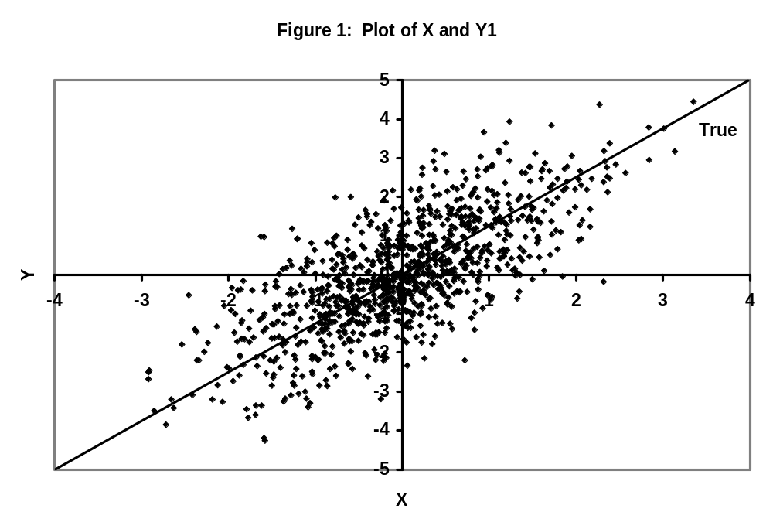

Slide 5
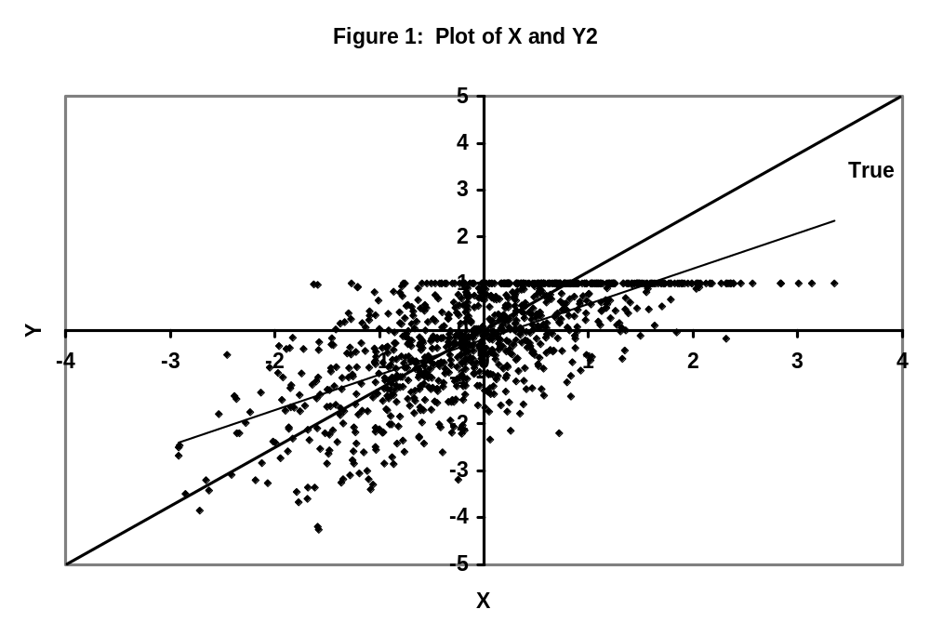

Slide 6
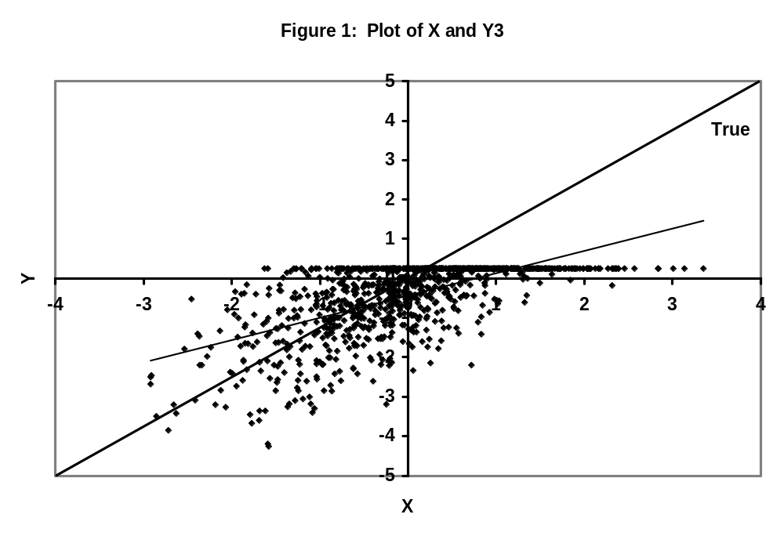

Slide 7
OLS Estimate of α and β
 | Dependent Variable |  |  | Ratio, β_{Yj}/ β_{Y1}
 | Y₁ | Y₂ | Y₃
α | 0.027 | -0.189 | -0.432
β | 1.023 | 0.755 | 0.565 | 0.738 | 0.553
% cen. (1-%cen) | 0 | 0.239 0.761 | 0.418 0.582

Slide 8
 | OLS using Y1 | Tobit using Y2 | Tobit using Y3
α | 1.0229 (0.027) | 1.0078 (0.036) | 0.9960 (0.041)
β | 0.027 (0.031) | 0.0133 (0.033) | -0.0001 (0.004)

Slide 9
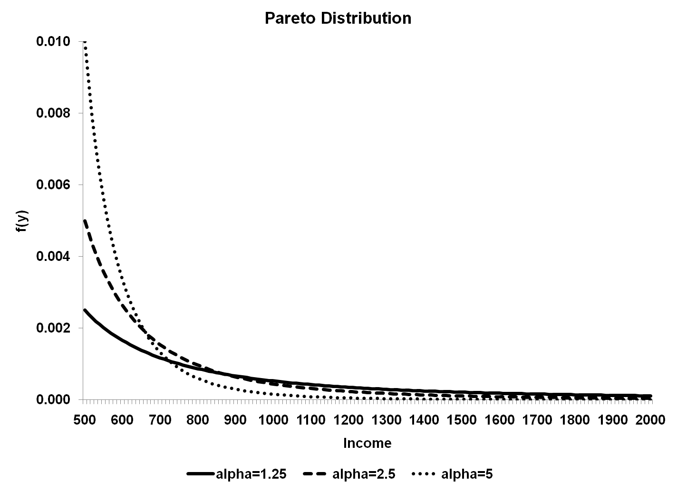

Slide 10
Example from CPS
Data from the 1987 CPS out-going rotation group
Households in CPS for same four months in a two year period (April-July 1987 and 1988)
¼ leave the sample temporarily or permanently each month
In these months, answer detailed questions about current employment

Slide 11
Union status
Usual hours, hours of overtime
Usual weekly earnings
In each survey, weekly earnings are ‘topcoded’
In the data we use (1987), topcoded at $999

Slide 12
Sample, 25% random sample of full-time/full year male workers, 21-64

Slide 13
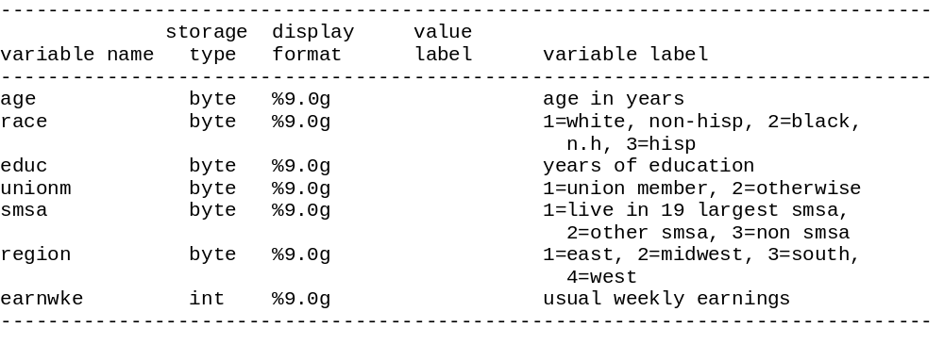

Slide 14
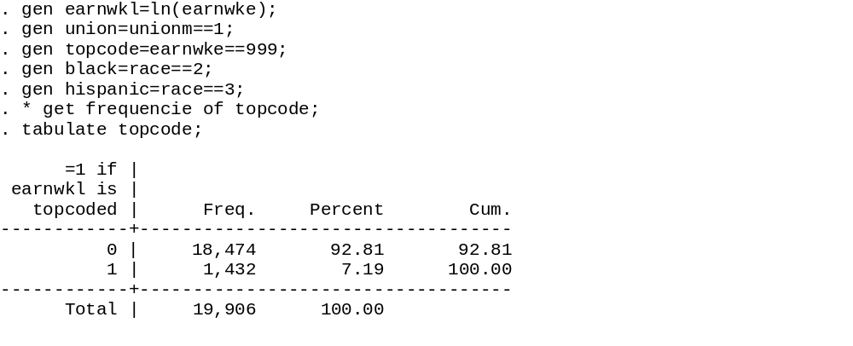
Need a variable
That identifies
What obs are censored
Fraction
Of obs
topcoded

Slide 15
. *run simple regression on topcoded data;
. reg earnwkl age age2 educ black hispanic union;
[delete results]
. * run tobit model;
. * here, ul specifies that the dependent variable is;
. * topcoded above (upper censoring);
. tobit earnwkl age age2 educ black hispanic union, ul;

Slide 16
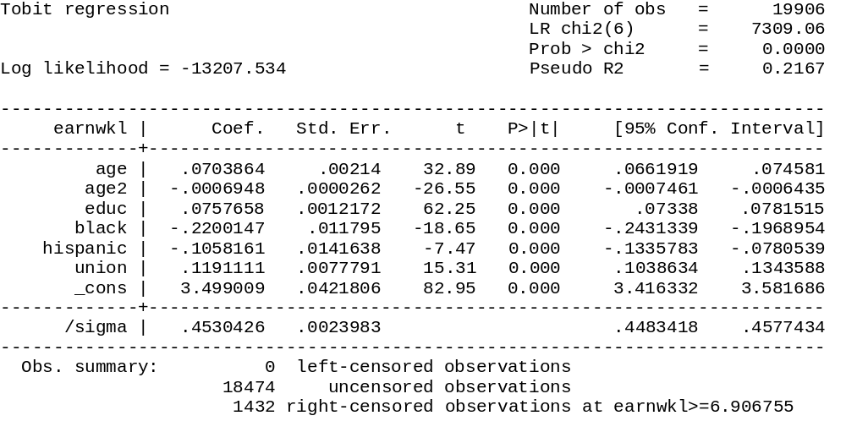
Similar to RMSE

Slide 17
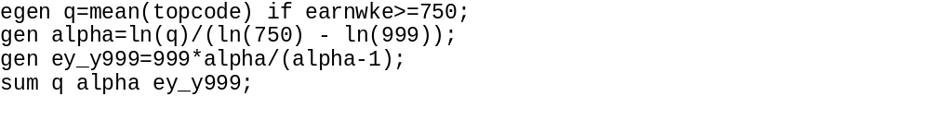
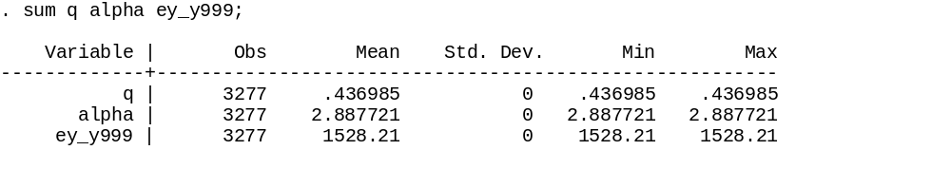
E[Y | Y>c] = αc/(α-1)
α = 2.89
E[Y | Y>999] = (2.89)(999)/(1.89) = 1528

Slide 18
OLS/Tobit when Income is Topcoded at $999
 | OLS | Tobit | QF | Tobit/ OLS
Age | 0.0679 | 0.0704 | 0.0723 | 0.964
Age2 | -6.8E-4 | -6.9E-4 | -7.1E-4 | 0.985
Educ | 0.0701 | 0.0757 | 0.0796 | 0.926
Black | -0.2130 | -0.2200 | -0.2252 | 0.968
Hispanic | -0.1096 | -0.1058 | -0.1049 | 1.036
Union | 0.1316 | 0.1191 | 0.1078 | 1.105

Slide 19
. * artifically topcode wages at 750;
. gen top750=earnwke>=750;
. gen earnwkl3=top750*ln(750) + (1-top750)*ln(earnwke);
. * run regression on model with artificially topcoded wages;
. reg earnwkl3 age age2 educ black hispanic union;

Slide 20
OLS/Tobit when Income is Topcoded at $750
 | OLS | Tobit | QF | Tobit/ OLS
Age | 0.06350 | 0.0704 | 0.0750 | 0.902
Age2 | -6.4E-4 | -6.9E-4 | -7.4E-4 | 0.927
Educ | 0.0614 | 0.0755 | 0.0817 | 0.813
Black | -0.2013 | -0.2211 | -0.2326 | 0.910
Hispanic | -0.1151 | -0.1054 | -0.1053 | 1.092
Union | 0.1493 | 0.1318 | 0.1161 | 1.132

